Slide 1
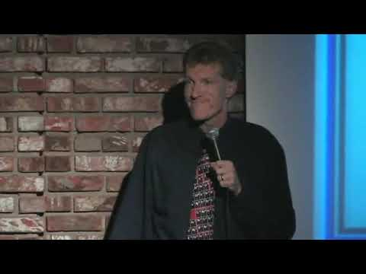
Notes:
Show the video of the come

Slide 2

Owning the stage

Slide 3

Stomp Hard

Slide 4

Understanding the audience relationship
Notes:
You are not in the stage to be loved by the audience. You are in the stage bc you love your audience

Slide 5

E is for …
Notes:
Entreating… Persuade Inspire … Inform
(Trojan horse)

